Slide 1
Usage of Casual Cyclistic Bike-Share Users
Presented by: Sonji Goodman
Last Updated: February 1, 2025

Slide 2
Table of Contents
Usage of Casual Cyclistic users
Objective (What are we talking about?)
Findings
Conclusion
Appendix

Slide 3
What are we talking about?

Slide 4
Objective
To examine the Cyclistic bike usage of casual users, how they differ from users with an annual membership based on the length of time the bikes are used, the days of the week the bikes are used, and the months with the heaviest usage.

Slide 5
Findings

Slide 6
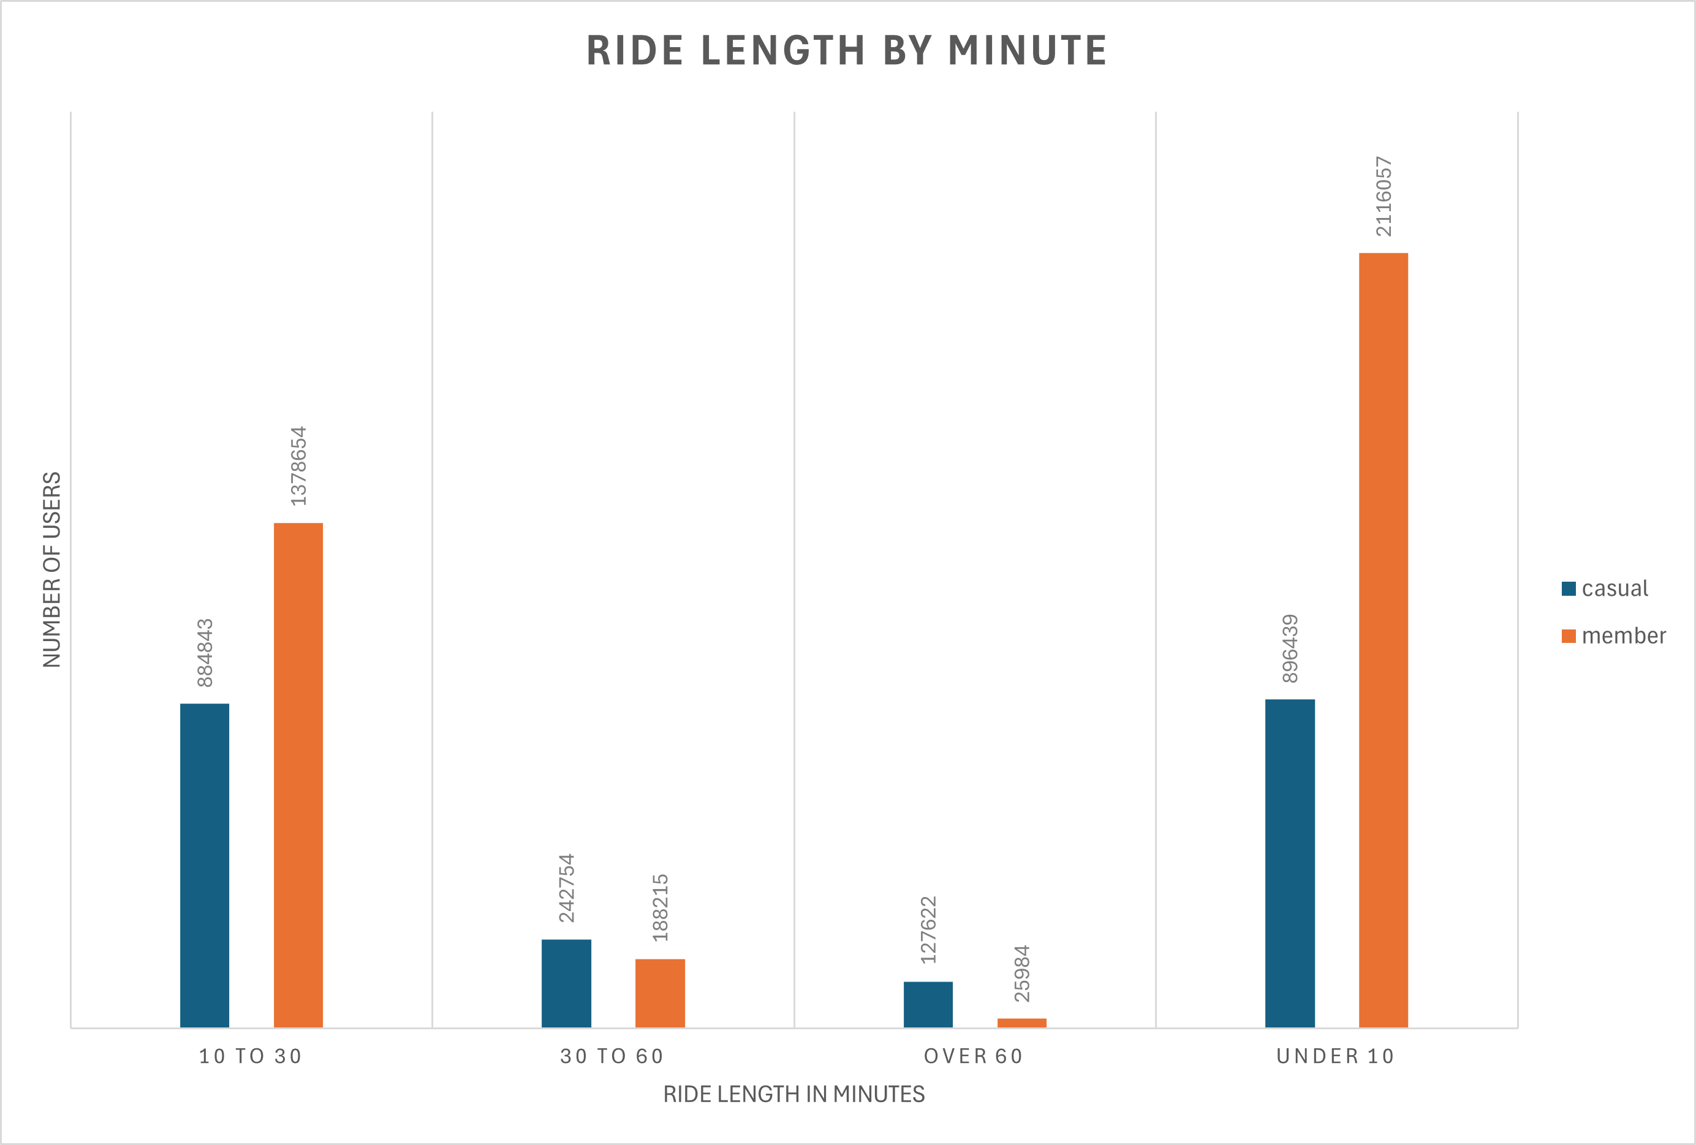
Duration of bike ride
Casual users, on average, use the bikes no longer than 30 minutes

Slide 7
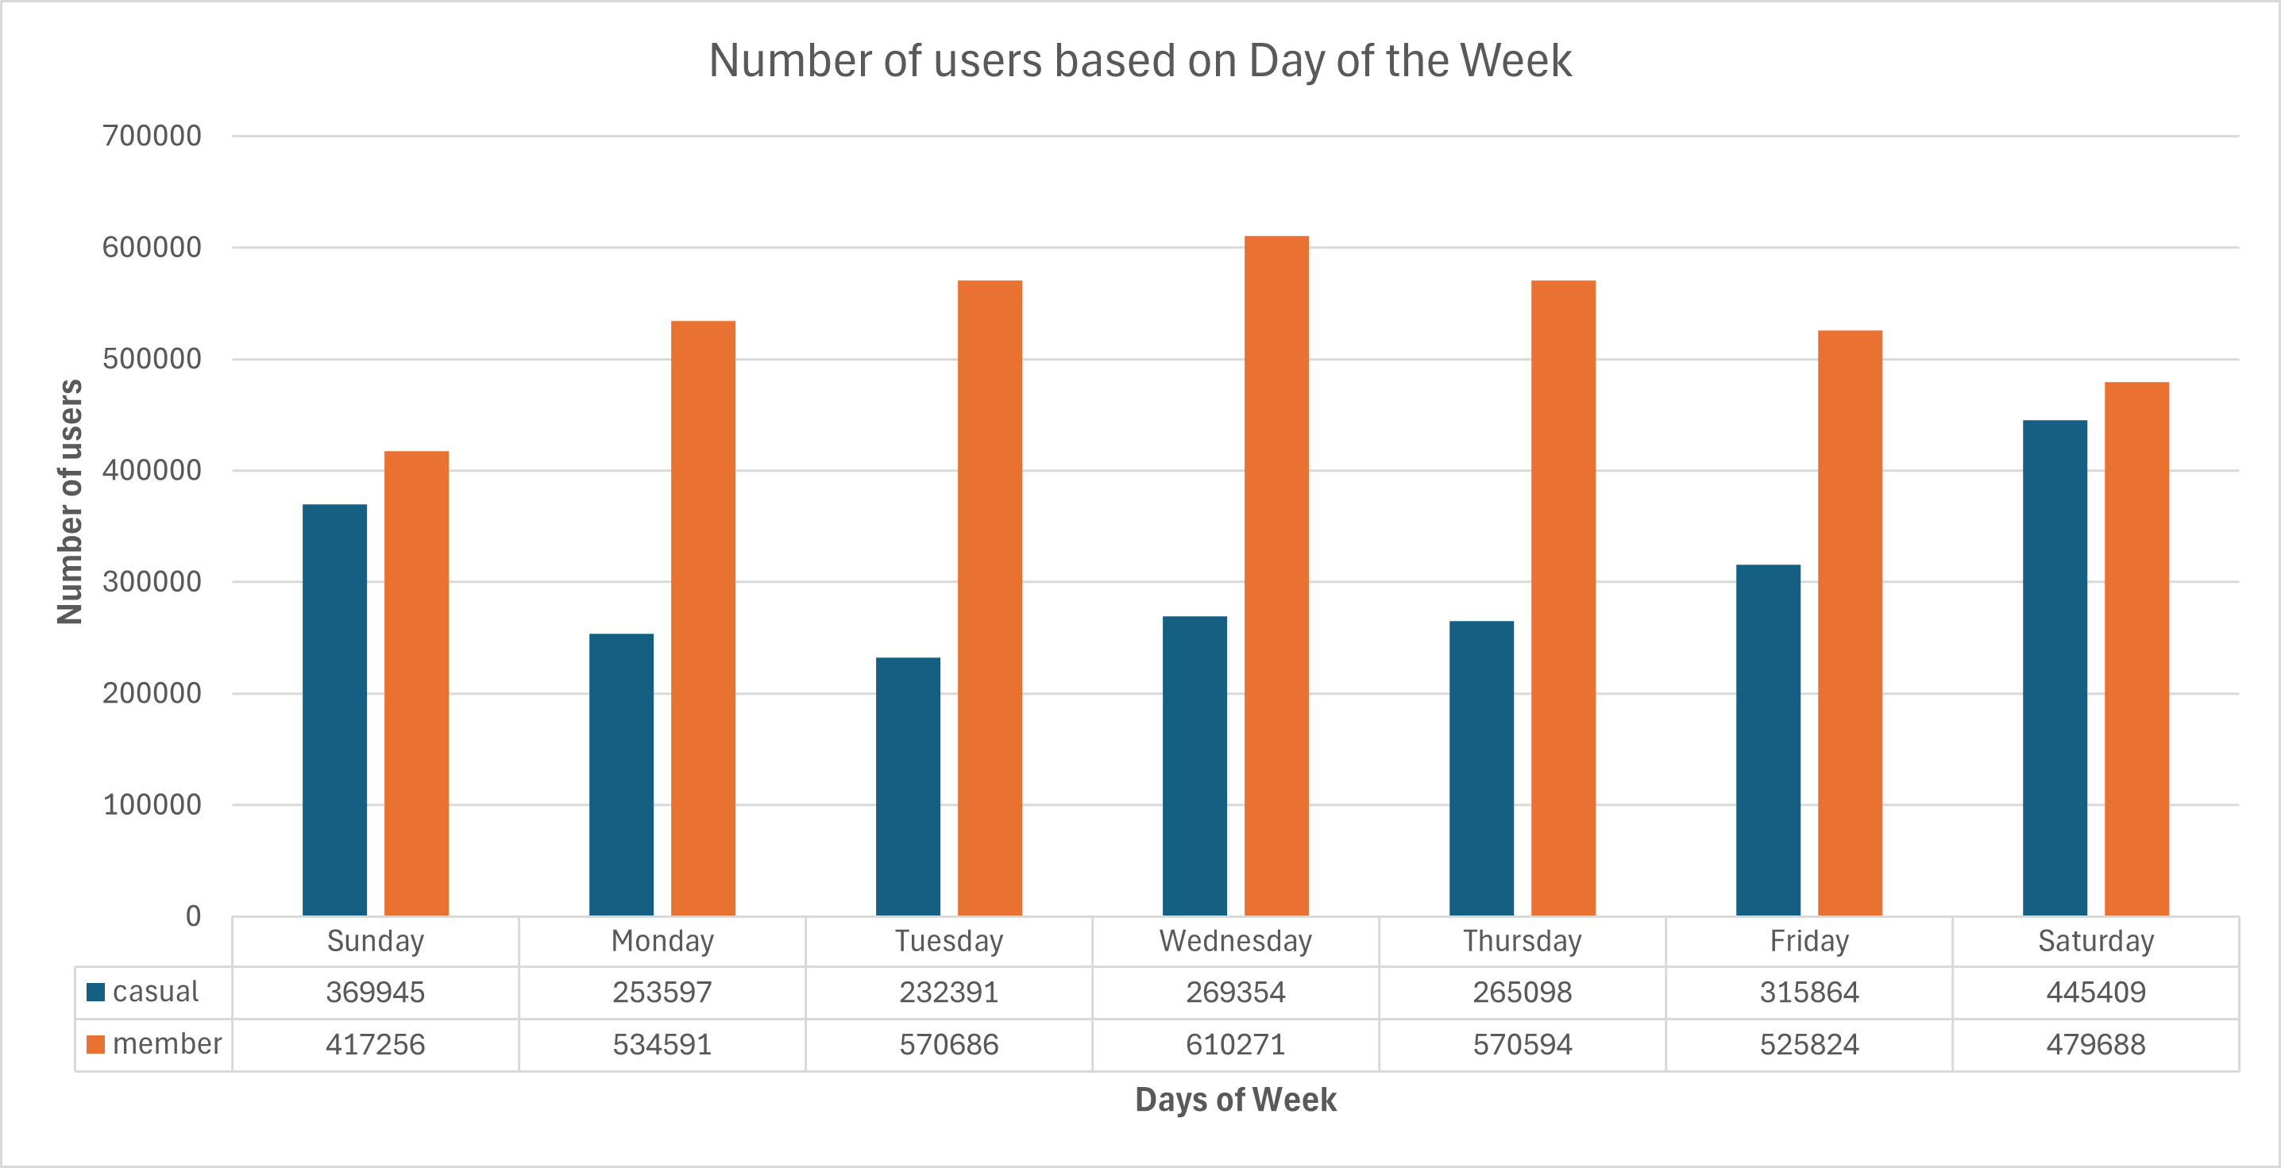
Busiest days of the week
Casual user use Cyclistic stations the most during the weekend (with Saturday being the busiest overall).

Slide 8
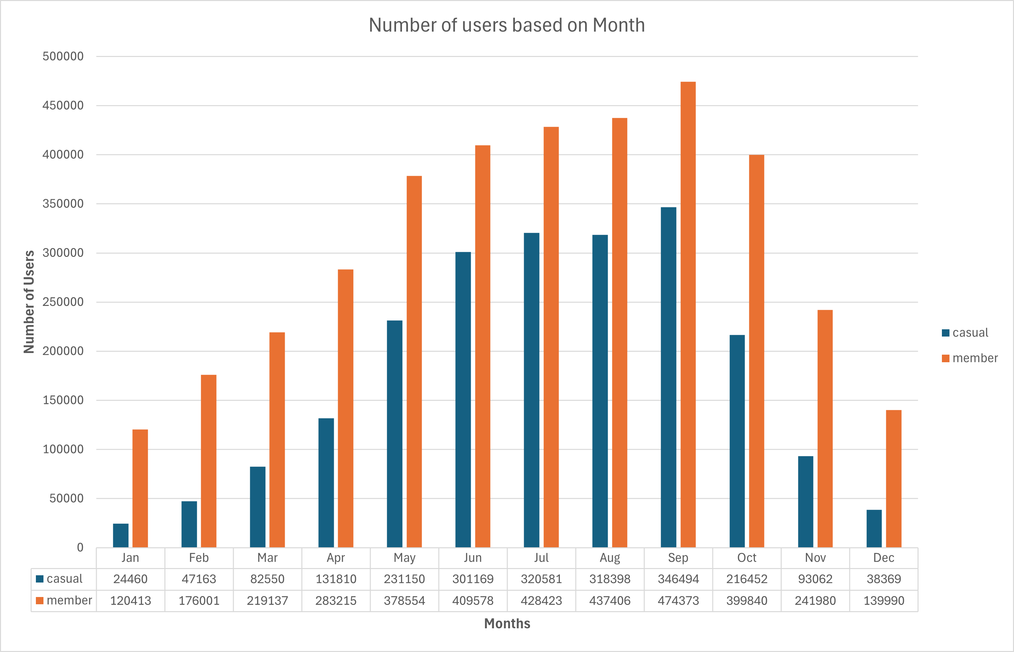
Busiest Months of the Year
Casual users are most active during the summer months, with its peak in September

Slide 9
Conclusion

Slide 10
Conclusions
Casual users, on average, use the bikes no longer than 30 minutes | Casual users use the bikes most on weekends. | Casual users are most active during the summer months, with its peak in September
1
2
3

Slide 11
Recommendations
Offer more Membership options (e.g.: a Seasonal Pass) | Target “Weekend Warriors” (people who get their fitness in on the weekends). | Launch campaign targeting Casuals close to summer
1
2
3

Slide 12
Thank you

Slide 13
Appendix

Slide 14
Power BI Dashboard

